Slide 1
Name Infinity
By: Jessie Wilkins and Jordan Throgmorton

Slide 2
Random Name Generation
Using Java we were able to use 2 processes for creating names
The 1st way is with premade names
The 2nd way is with new names
Both ways have their own rules to follow but also similar ones too

Slide 3
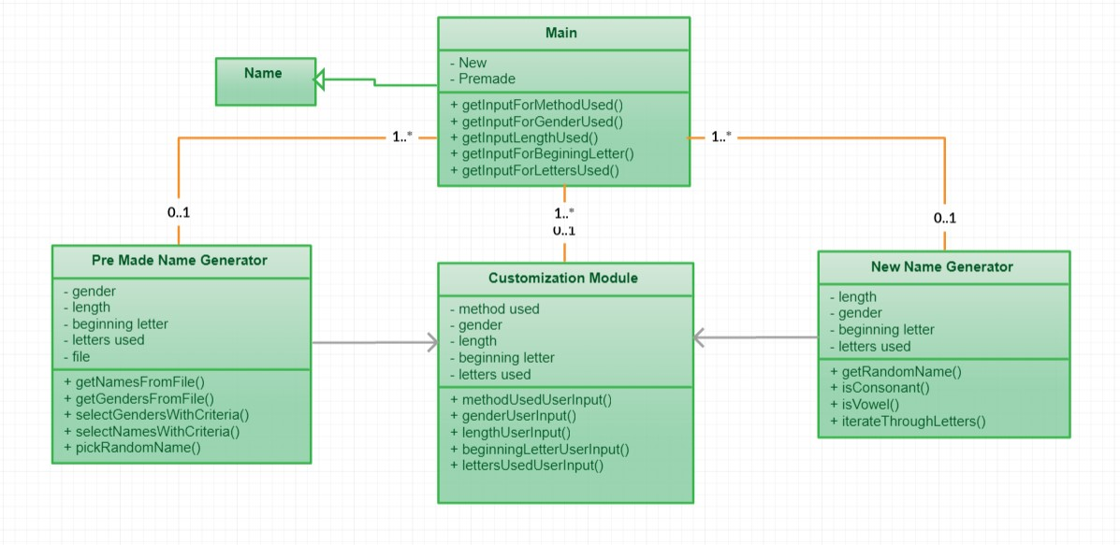
Class Diagram

Slide 4
Customization Module
This allows the user to give guidelines to the name such as
Premade or New names
Gender of name
Beginning letter
Length
Letters used

Slide 5
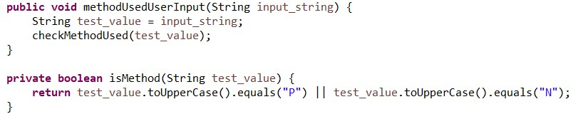
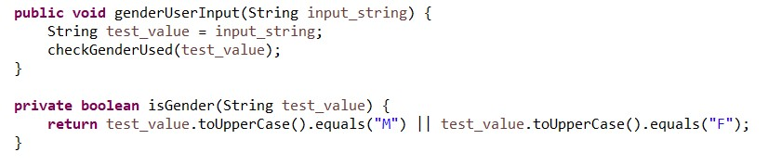

Customization Module Functions

Slide 6
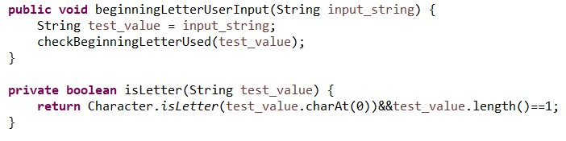

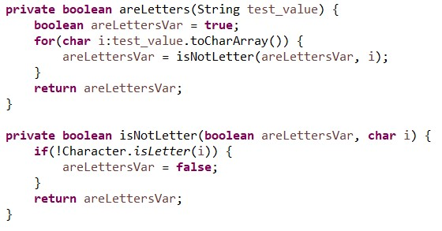
Functions Continued

Slide 7
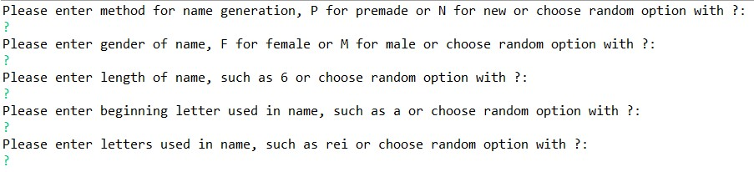
Example

Slide 8
Premade names
Chosen from list of names in a file
Has to follow user criteria when selecting a name

Slide 9
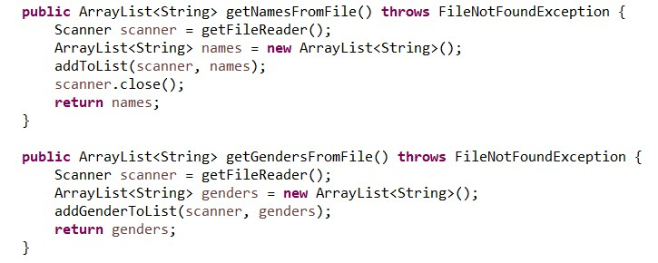
Premade Functions

Slide 10
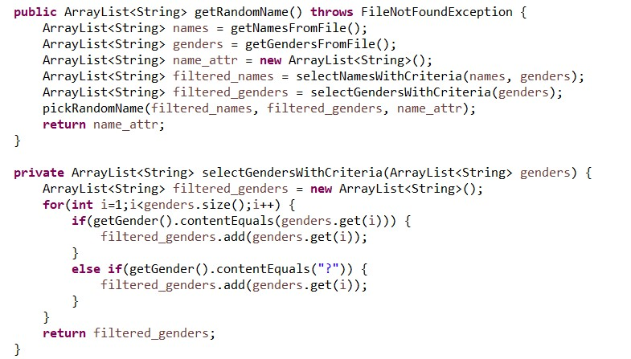

Slide 11
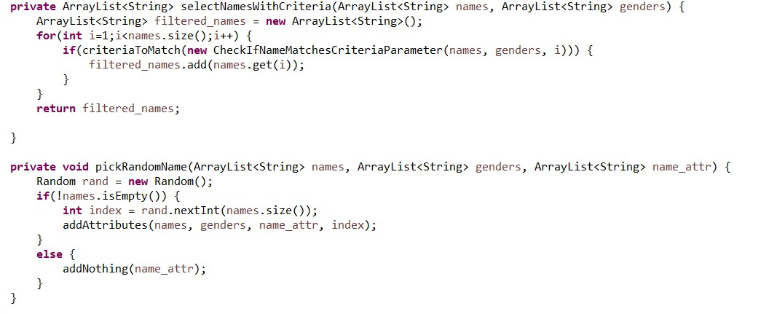

Slide 12
New Names
Created from array of characters
Also follows user criteria for name
Difference:
- name creation has follow special rules

Slide 13
Name rules
No beginning contiguous consonants
No more than 2 contiguous consonants
No more than 2 contiguous vowels
Does not end with 2 contiguous consonants

Slide 14
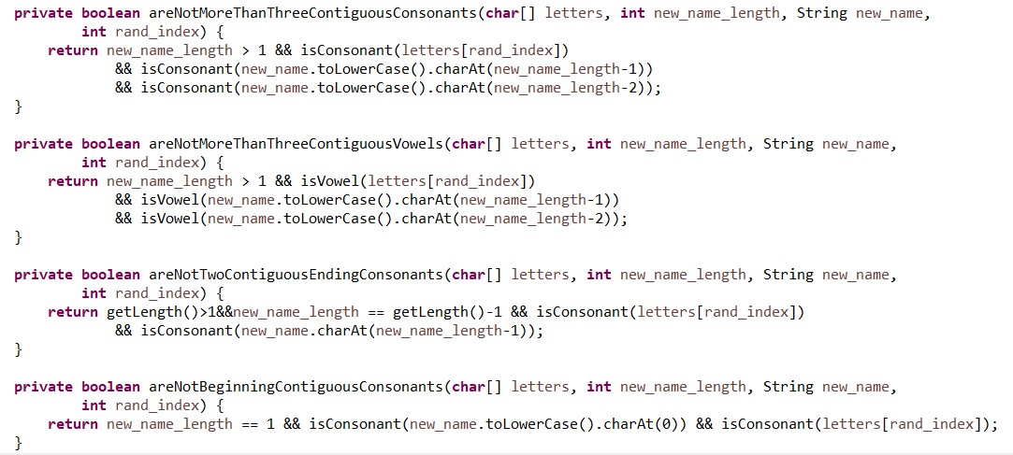
New name Functions

